Slide 1
Graph Query Matching & Graphs Isomorphism Counting lecture-8 Course on Machine Learning on Spatio-Temporal Graphs (Summer Term 22)
Prof. Dr. Holger Giese (holger.giese@hpi.uni-potsdam.de)
Christian Medeiros Adriano (christian.adriano@hpi.de) - “Chris”
Matthias Barkowsky (matthias.barkowsky@hpi.de )
Iqra Zafar (iqra.zafar@hpi.de)

Slide 2
Intro
Graph Isomorphism task consists of counting the number of subgraphs in graph database that present the same configuration of nodes and edges.
Graph Matching task consists of finding the number of graphs that match a given query, which is represented by a graph.
Graph Isomorphism Counting
Graph Query Matching

Slide 3
Challenges Traditional Methods
NP-complete problems [Wang et al., 2021;Bai et al., 2021]:
- graph edit distance (GED) [Sanfeliu and Fu, 1983]: minimum number of editing operations required to convert one graph to the other
- maximum common subgraph (MCS) [Bunke, 1997]: find the largest induced subgraph common to two given graphs
Current shortcomings:
- Traditional methods A* [Neuhaus et al., 2006] and Hungarian [Riesen and Bunke, 2009] can accurately solve the problem of GED, but they have very high computational complexity
- Traditional search algorithms mainly consider the graph structure, while ignoring the rich attribute information contained in the graph, including node features, edge features
Therefore, to compute the graph distances, people begin to use graph neural networks (GNNs) to learn the similarity between two graphs [Li et al., 2019]
Notes:
CGMN: A Contrastive Graph Matching Network for Self-Supervised Graph <<<<<<<<<<RELATED WORK
Similarity Learning
https://shiruipan.github.io/publication/ijcai-22-jin/ijcai-22-jin.pdf

Slide 4
Two fundamental challenges of GNNs
Expressivity = repeated neighbor mixing collapses embeddings of different nodes into a fixed low-dimensional subspace.
Scalability = recursive expansion of neighbor nodes results in exponentially growing neighborhood size.

Slide 5
Graph Query Matching
Goal: find out the query graph from the data graph, i.e., it is a search problem that involves ranking results (matches)

Slide 6
Neuro Subgraph Matching [Ying 2020]
Limitations of previous work (Bai et al., 2019; Li et al., 2019; Xu et al., 2019):
embed graphs into vector spaces
→ do not impose geometric structure in the embedding space.
Conversely, using a GNN creates an ordered embedding that
→leads to a well-structured embedding space
→allows to efficiently navigate it in order to find subgraphs as well as supergraph
source: Ying, et al., 2020, Neural Subgraph Matching
Notes:
Yunsheng Bai, Hao Ding, Song Bian, Ting Chen, Yizhou Sun, and Wei Wang. Simgnn: A neural network approach to fast graph similarity computation. In WSDM. ACM, 2019
Yujia Li, Chenjie Gu, Thomas Dullien, Oriol Vinyals, and Pushmeet Kohli. Graph matching networks for learning the similarity of graph structured objects. In ICML, 2019.
Kun Xu, Liwei Wang, Mo Yu, Yansong Feng, Yan Song, Zhiguo Wang, and Dong Yu. Cross-lingual knowledge graph alignment via graph matching neural network. 2019

Slide 7
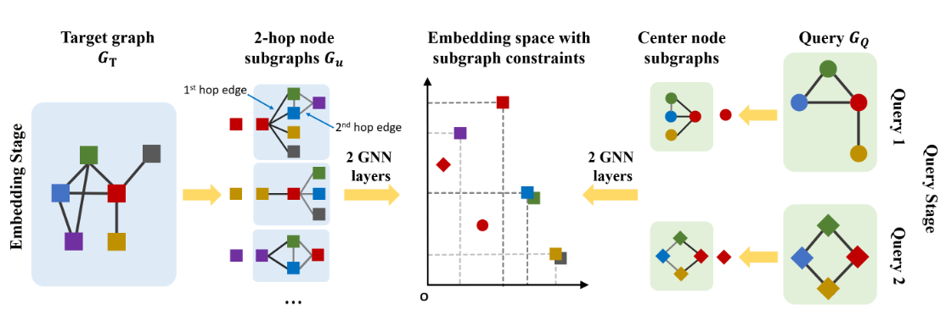
Framework of Neuro Subgraph Matching [Ying 2020]
Max-margin loss is used to ensure that the subgraph relationships are captured
GNN is trained to learn the order embedding
source: Ying, et al., 2020, Neural Subgraph Matching

Slide 8
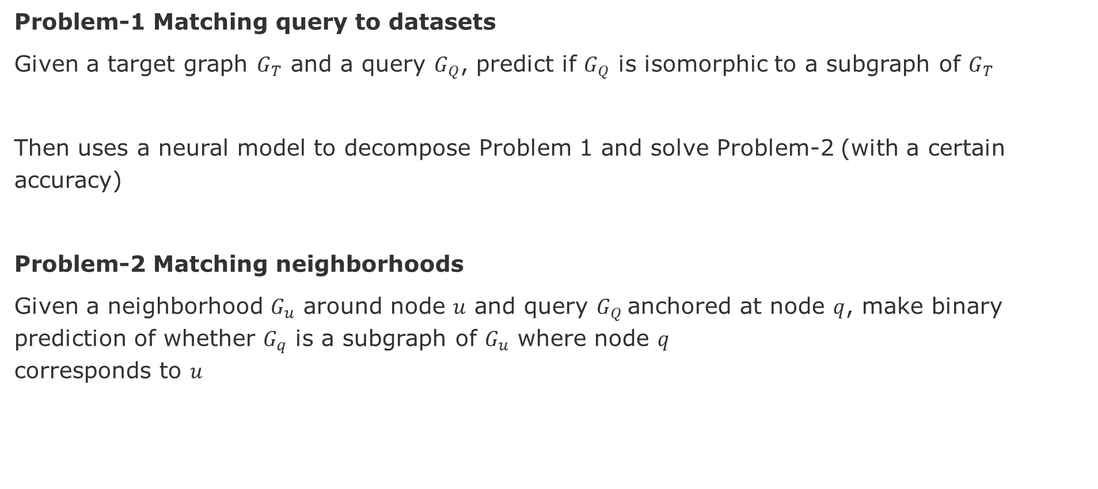
Decision problems of subgraph matching
Problem-1 Matching query to datasets
Given a target graph $G_{T}$ and a query $G_{Q}$, predict if $G_{Q}$ is isomorphic to a subgraph of $G_{T}$
Then uses a neural model to decompose Problem 1 and solve Problem-2 (with a certain accuracy)
Problem-2 Matching neighborhoods
Given a neighborhood $G_{u}$ around node $u$ and query $G_{Q}$anchored at node $q$, make binary prediction of whether $G_{q}$ is a subgraph of $G_{u}$ where node $q$ corresponds to $u$
Caveat - GNNs are good at similarity measurement tasks but are not good at substructure extraction tasks: shortest path, subgraph, self-loop, etc.

Slide 9
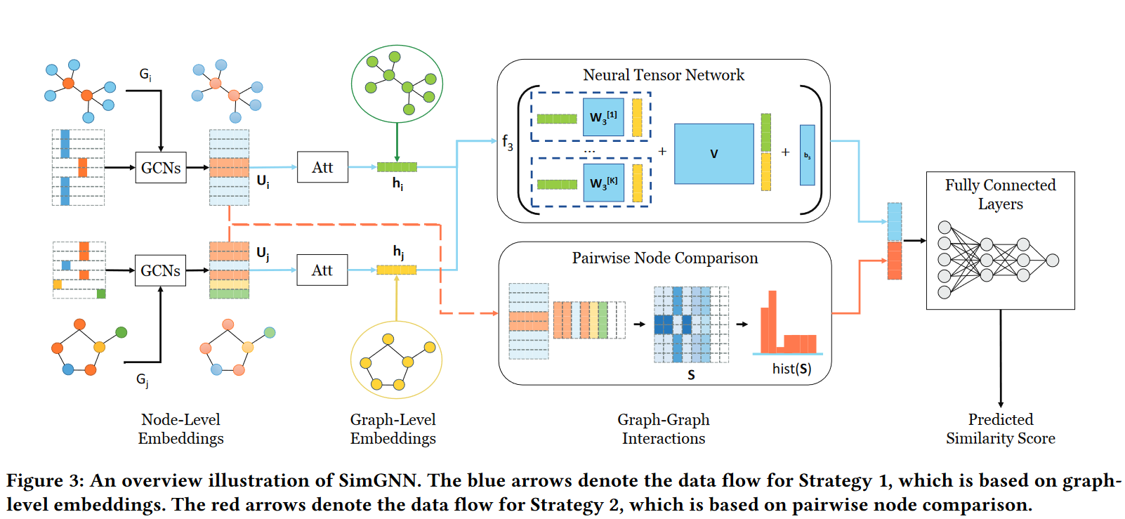
Simgnn: approach to fast graph similarity [Bai 2019]
Bai, et al., 2019, Simgnn: A neural network approach to fast graph similarity computation.

Slide 10
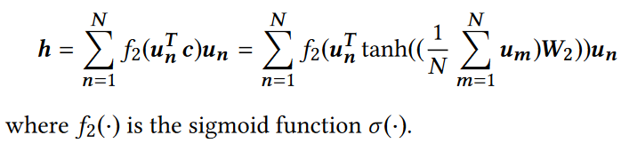
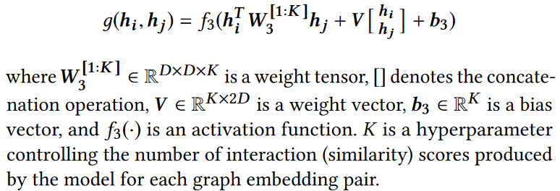
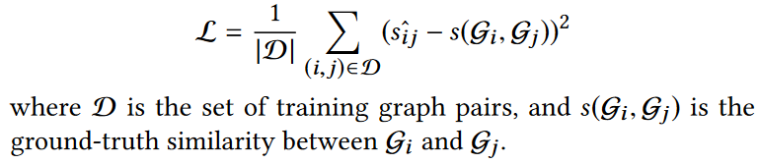
Simgnn: approach to fast graph similarity [Bai 2019]
Graph attentive mechanism
Graph-Graph Interaction
Graph Similarity Score
Bai, et al., 2019, Simgnn: A neural network approach to fast graph similarity computation.
Notes:
Bai, et al., 2019, Simgnn: A neural network approach to fast graph similarity computation.
https://waterpine.github.io/paper/2019_WSDM_SimGNN.pdf

Slide 11
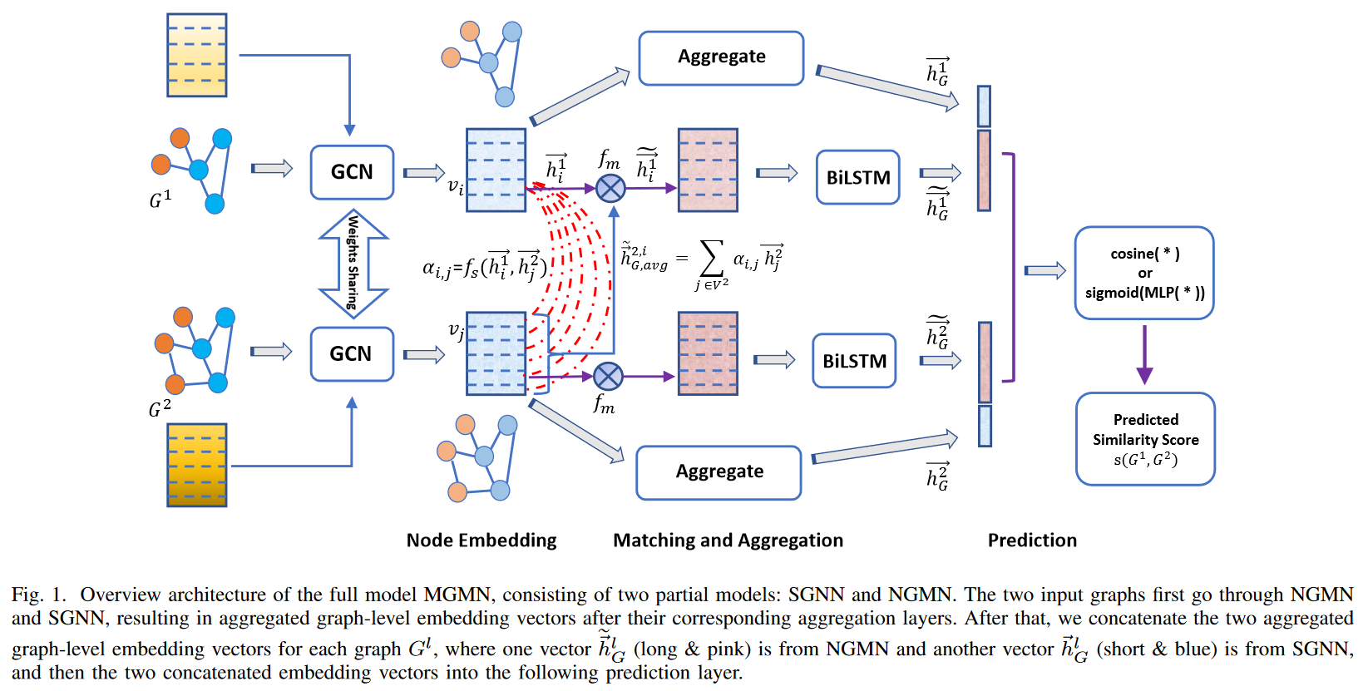
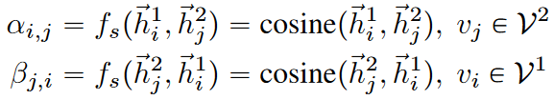
Hierarchical graph matching network for graph similarity [Xiu 2020][Ling 2021]
takes a random permutation of the node embeddings and concatenates the two last hidden vectors from both directions of BI-LSTM
Graph-Graph binary classification {-1,1}
Graph-Graph regression continuous similarity (0,1])
Xiu, et al., 2020, Hierarchical graph matching network for graph similarity computation
Ling, et al., 2021, Multilevel Graph Matching Networks for Deep Graph Similarity Learning
Notes:
Xiu, et al., 2020, Hierarchical graph matching network for graph similarity computation
- https://openreview.net/pdf?id=rkeqn1rtDH
Ling, et al., 2021, Multilevel Graph Matching Networks for Deep Graph Similarity Learning
https://owa.hpi.uni-potsdam.de/owa/#path=/mail

Slide 12
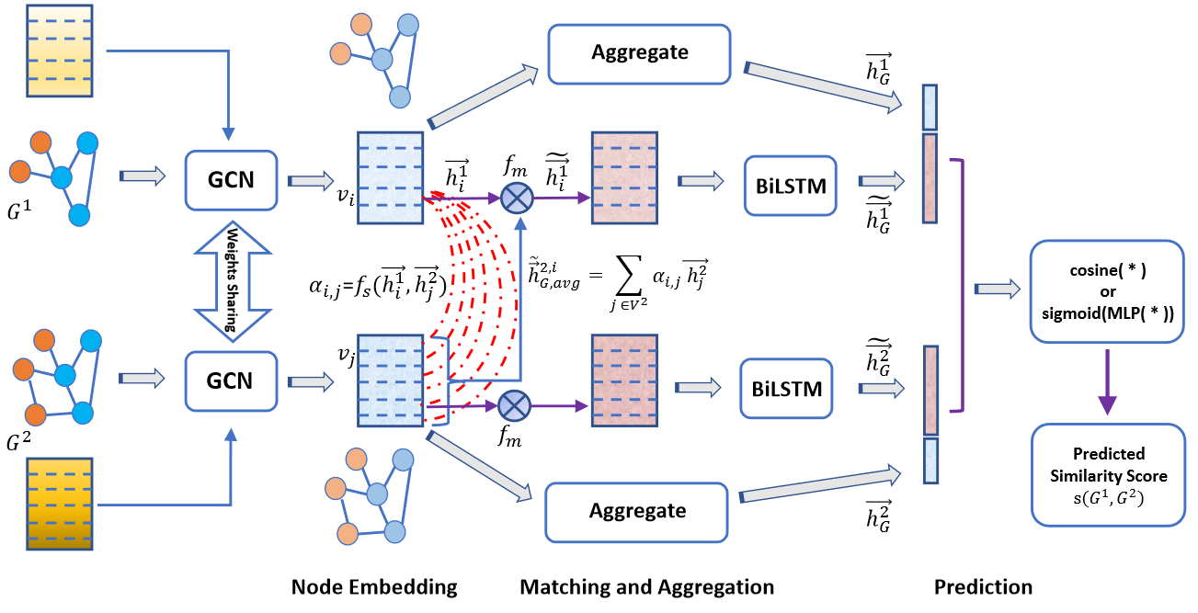
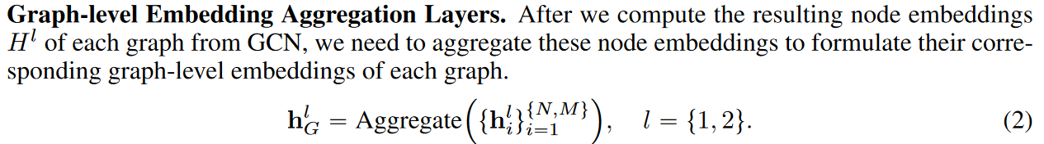
Hierarchical graph matching network for graph similarity [Xiu et al. 2020]
Node Embedding Layer
Xiu, et al., 2020, Hierarchical graph matching network for graph similarity computation
Ling, et al., 2021, Multilevel Graph Matching Networks for Deep Graph Similarity Learning
Notes:
Xiu, et al., 2020, Hierarchical graph matching network for graph similarity computation
- https://arxiv.org/pdf/2007.04395.pdf

Slide 13
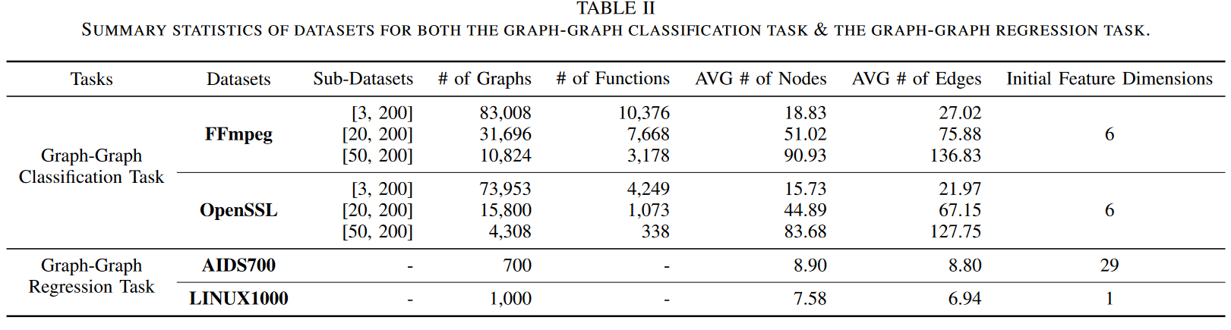
Hierarchical graph matching network for graph similarity [Xiu et al. 2020]
Xiu, et al., 2020, Hierarchical graph matching network for graph similarity computation
Ling, et al., 2021, Multilevel Graph Matching Networks for Deep Graph Similarity Learning
Notes:
Xiu, et al., 2020, Hierarchical graph matching network for graph similarity computation
- https://arxiv.org/pdf/2007.04395.pdf

Slide 14
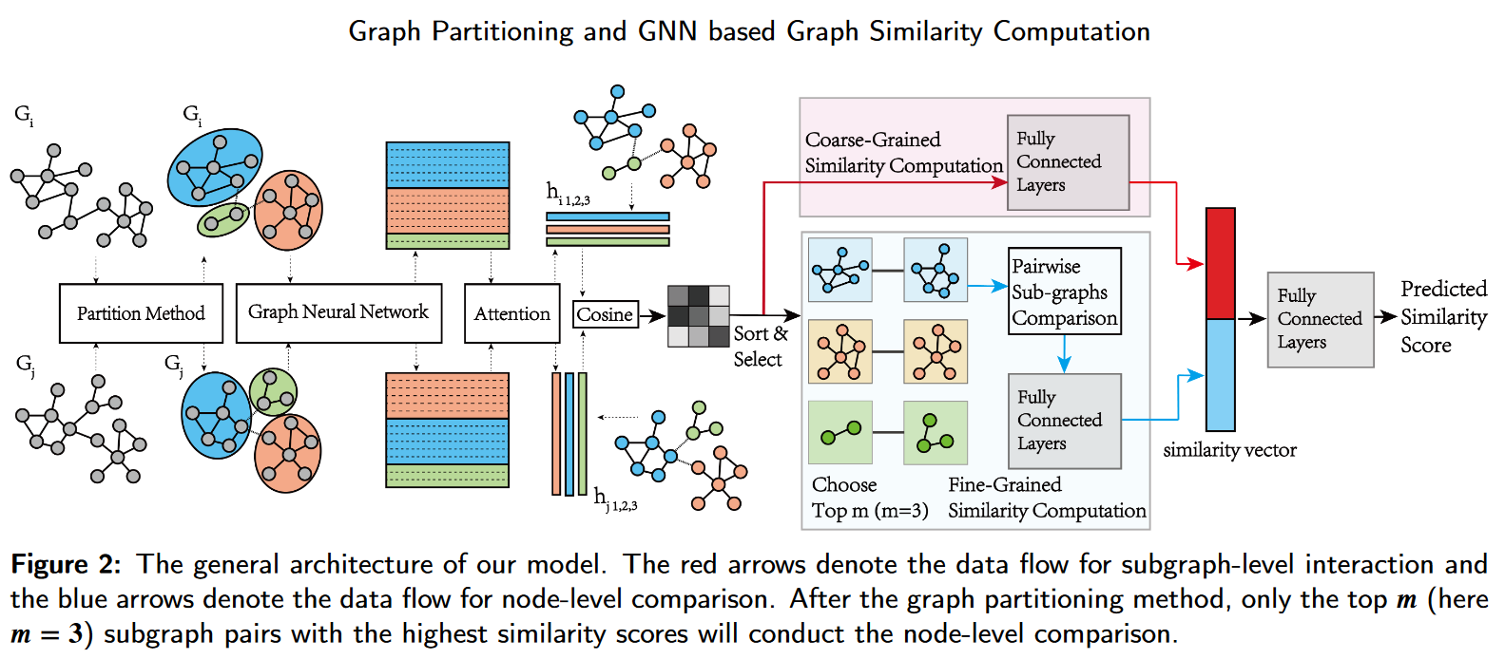
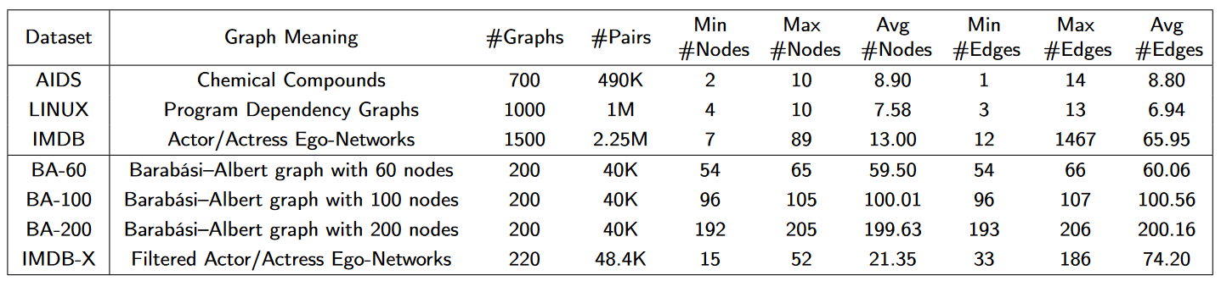
GNN Hierarchical Graph Matching for Graph Similarity Computation [Xu et al. 2021]
Xu et al. 2021, Graph Partitioning and Graph Neural Network based Hierarchical Graph Matching for Graph Similarity Computation
Notes:
Xu et al. 2021, Graph Partitioning and Graph Neural Network based Hierarchical Graph Matching for Graph Similarity Computation

Slide 15
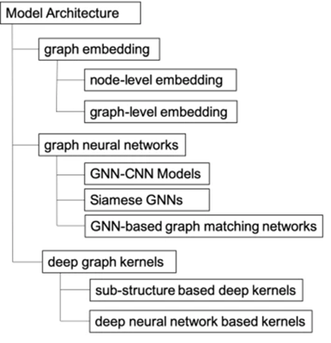
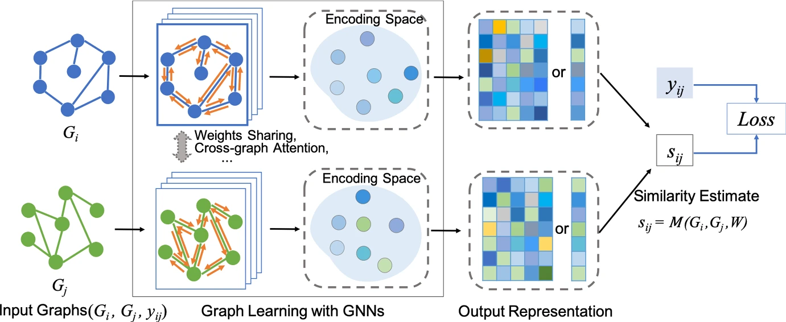
Deep graph similarity learning: a survey [Ma 2021]
Ma, et al., 2021, Deep graph similarity learning: a survey
Notes:
Ma et al., 2021, Deep graph similarity learning: a survey
https://link.springer.com/article/10.1007/s10618-020-00733-5

Slide 16
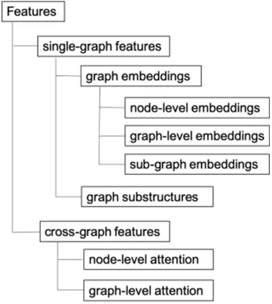
Deep graph similarity learning: a survey [Ma 2021]
Ma, et al., 2021, Deep graph similarity learning: a survey
Notes:
Ma et al., 2021, Deep graph similarity learning: a survey
https://link.springer.com/article/10.1007/s10618-020-00733-5

Slide 17
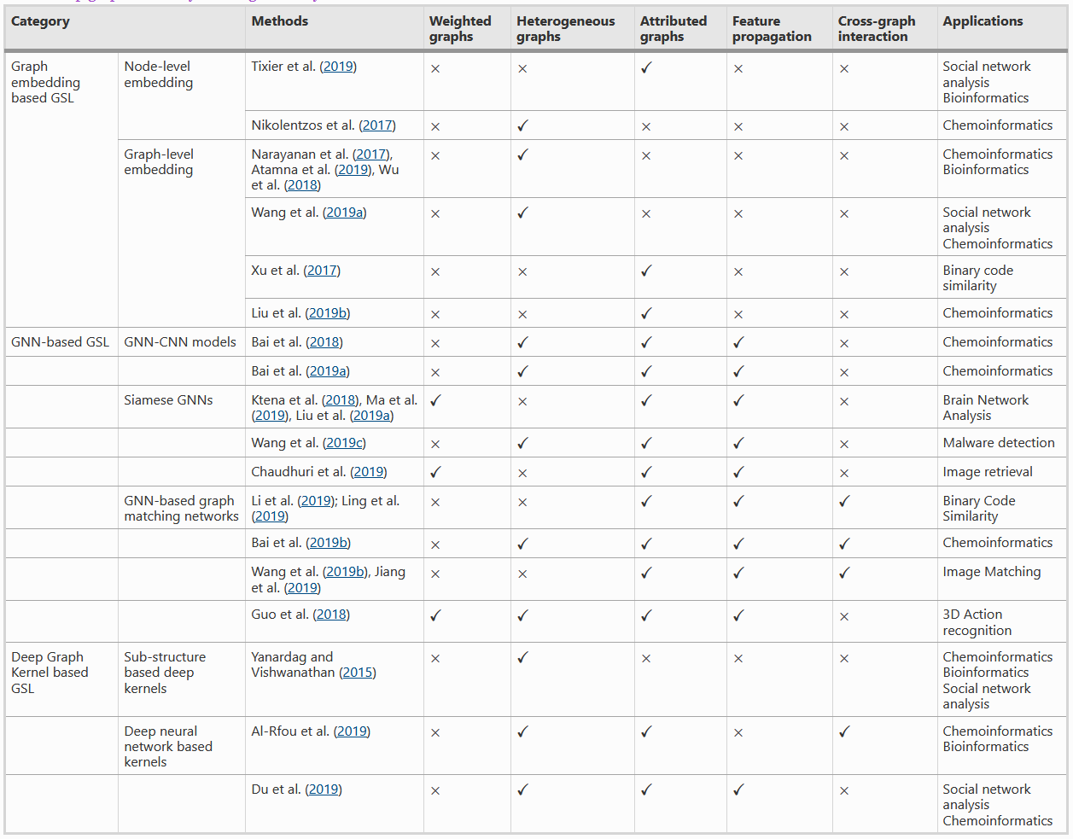
Taxonomy [Ma 2021]
Source: https://link.springer.com/article/10.1007/s10618-020-00733-5/tables/2
Ma, et al., 2021, Deep graph similarity learning: a survey
Notes:
Ma et al., 2021, Deep graph similarity learning: a survey
https://link.springer.com/article/10.1007/s10618-020-00733-5

Slide 18
Challenge on Dynamic and Streaming Graphs
Quoting [Ma 2021]:
“The similarity learning would be important for change/anomaly detection, link prediction, relationship strength prediction, etc. Although some work has proposed variants of GNN models for spatio-temporal graphs (Yu et al. 2017; Manessi et al. 2020), and other learning methods for dynamic graphs (Nguyen et al. 2018a, b; Tong et al. 2008; Li et al. 2017), the similarity learning problem on dynamic and streaming graphs has not been well studied.
… to the best of our knowledge, none of the existing similarity learning methods is no able to deal with such spatio-temporal graphs.
The main challenge in such problems is how to leverage the temporal updates of the node-level representations and the interactions between the nodes on these graphs while modeling their similarity.”
Ma, et al., 2021, Deep graph similarity learning: a survey

Slide 19
Challenges - Interpretability
Quoting [Ma 2021]: complex process and makes it challenging to explain the learning results
….
In Ying et al. (2019), a GNNEXPLAINER … (1) identifies a subgraph structure and a subset of node features that are crucial in a prediction. (2) formulates an optimization task that maximizes the mutual information between a GNN’s prediction and the distribution of possible subgraph structures.
Baldassarre and Azizpour (2019) explores the explainability of GNNs using gradient-based and decomposition-based method
However, these are mostly for node classification or link prediction tasks on a graph!
To the best of our knowledge, the explainability of GNN-based graph similarity models remains unexplored.

Slide 20
Challenges – Few shot learning
Quoting [Ma 2021]: The task of few-shot learning is to learn classifiers for new classes with only a few training examples per class
…
Since graph data usually has complex structure, how to learn a metric so that it can facilitate generalizing from a few graph examples is a big challenge.
…
Some recent work (Guo et al. 2018) has begun to explore the few-shot 3D action recognition problem with graph-based similarity learning strategies.
…
neural graph matching network is proposed to jointly learn a graph generator and a graph matching metric function to optimize the few-shot learning objective of 3D action recognition
…
problem is to design general deep graph similarity learning models for the few-shot learning task for a multitude of applications”
Too domain-specific
Event Propagation?!

Slide 21
References Graph Query Matching
Ying, Z., Wang, A., You, J., Wen, C., Canedo, A., & Leskovec, J. (2020). Neural subgraph matching.
Lan, Z., Yu, L., Yuan, L., Wu, Z., Niu, Q., & Ma, F. (2021). Sub-GMN: The Subgraph Matching Network Model. arXiv preprint arXiv:2104.00186.
Sarlin, P. E., DeTone, D., Malisiewicz, T., & Rabinovich, A. (2020). Superglue: Learning feature matching with graph neural networks. In Proceedings of the IEEE/CVF, pp. 4938-4947. Data and code are available at https://github.com/magicleap/SuperGluePretrainedNetwork
Krleža, D., & Fertalj, K. (2016). Graph matching using hierarchical fuzzy graph neural networks. IEEE Transactions on Fuzzy Systems, 25(4), 892-904.
Zhou, J., Cui, G., Hu, S., Zhang, Z., Yang, C., Liu, Z., ... & Sun, M. (2020). Graph neural networks: A review of methods and applications. AI Open, 1, 57-81.
your suggestion? (e.g., check papers 2021 and 2022)

Slide 22
Graph Isomorphism Counting
Goal: find the number of query graphs (isomorphism, graph structures) in the data graph.

Slide 23
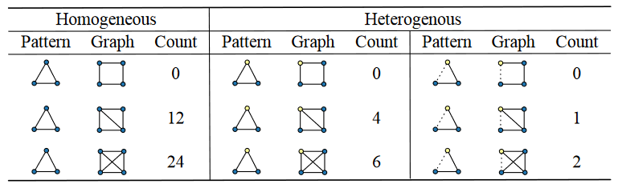
Different Settings for Counting
Homogeneous graphs
Heterogeneous node graphs
two types of nodes
Heterogeneous nodes and heterogeneous edge graphs
two types of nodes and two types of edges
A
B
C
source: Liu et al., 2020, Neural Subgraph Isomorphism Counting, KDD '20
Notes:
Liu et al., 2020, Neural Subgraph Isomorphism Counting, KDD '20, August 23–27, 2020

Slide 24
Intuition of the Graph Counting Problem
The counting problem can be formulated as a question-answering problem, which is well established in natural language processing, but with slight difference in the outcome:
Question Answering Model (Text Queries):
answers are facts extracted from the provided texts
Graph Counting Model:
answers are summary statistics of matched local patterns.
source: Liu et al., 2020, Neural Subgraph Isomorphism Counting, KDD '20

Slide 25
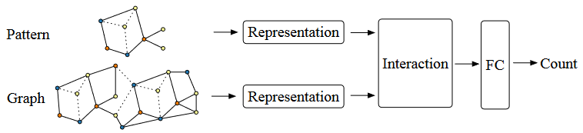
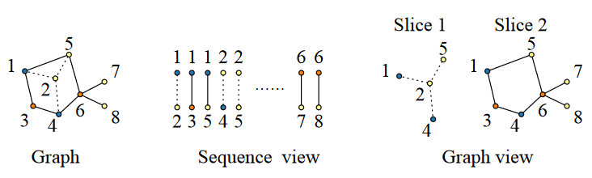
Framework - neural subgraph isomorphism counting models [Liu 2020]
Encoding makes the problem learnable.
Caveat: Learning based approaches are inexact
Query
Graph database
The encoding of the graph (or the pattern) should be either represented as:
A- sequence of edges, or
B- a series of adjacent matrices and vertex features.
A
B
source: Liu et al., 2020, Neural Subgraph Isomorphism Counting, KDD '20

Slide 26
Results [Liu et al. 2020]
Generalized to count large patterns and data graphs in linear time compared to the exponential time of the original NP-complete problem.
Experimental results showed that learning based subgraph isomorphism counting can speed up the traditional algorithm (VF2) in up to 1000 times with acceptable errors.
Data and code are available at https://github.com/HKUST-KnowComp/NeuralSubgraphCounting

Slide 27
References Graph Isomorphism Counting
Liu, X., Pan, H., He, M., Song, Y., Jiang, X., & Shang, L. (2020, August). Neural subgraph isomorphism counting. In Proceedings of the 26th ACM SIGKDD, pp. 1959-1969, Data and code are available at https://github.com/HKUST-KnowComp/NeuralSubgraphCounting
Bouritsas, G., Frasca, F., Zafeiriou, S., & Bronstein, M. M. (2020). Improving graph neural network expressivity via subgraph isomorphism counting. arXiv preprint arXiv:2006.09252
Chen, Z., Chen, L., Villar, S., & Bruna, J. (2020). Can graph neural networks count substructures?. arXiv preprint arXiv:2002.04025.
Tahmasebi, B., Lim, D., & Jegelka, S. (2020). Counting substructures with higher-order graph neural networks: Possibility and impossibility results. arXiv preprint arXiv:2012.03174.
You, J., Gomes-Selman, J., Ying, R., & Leskovec, J. (2021). Identity-aware graph neural networks. arXiv preprint arXiv:2101.10320.
… your suggestion?

Slide 28
GNNs and Weisfeiler-Lehman Isomorphism Test
Weisfeiler and Leman go Machine Learning: The Story so far, 2022
https://arxiv.org/pdf/2112.09992.pdf
1-WL Expressiveness Is (Almost) All You Need.“, 2022. https://arxiv.org/pdf/2202.10156 https://arxiv.org/pdf/2202.10156
Weisfeiler and Lehman go topological: Message passing simplicial networks, 2021 https://www.hpi.uni-potsdam.de/giese/bibadmin/show.php?id=17130
The Power of the Weisfeiler-Lehman Algorithm for Machine Learning with Graphs, 2021
https://www.hpi.uni-potsdam.de/giese/bibadmin/show.php?id=17134
word2vec, node2vec, graph2vec, x2vec: Towards a theory of vector embeddings of structured data, 2020
https://www.hpi.uni-potsdam.de/giese/bibadmin/show.php?id=17149

Slide 29
Additional topics

Slide 30
Querying with GNNs
The expressive power of graph neural networks as a query language, 2020
https://www.hpi.uni-potsdam.de/giese/bibadmin/show.php?id=17147
Representing Schema Structure with Graph Neural Networks for Text-to-SQL Parsing, 2019
https://www.hpi.uni-potsdam.de/giese/bibadmin/show.php?id=17146
The relational data borg is learning
https://www.hpi.uni-potsdam.de/giese/bibadmin/show.php?id=17148

Slide 31
Equivariance and Expressiviness of GNNs
Expressive power of invariant and equivariant graph neural networks, 2020
https://www.hpi.uni-potsdam.de/giese/bibadmin/show.php?id=17139
Equivariant Subgraph Aggregation Networks, 2021
https://www.hpi.uni-potsdam.de/giese/bibadmin/show.php?id=17136

Slide 32
Search Plan Generation
Search Plan Generation
https://link.springer.com/chapter/10.1007/11841883_27 (static search plans)
https://link.springer.com/article/10.1007/s10270-013-0372-2 (static search plans)
https://journal.ub.tu-berlin.de/eceasst/article/view/268 (dynamic search plans)
https://link.springer.com/chapter/10.1007/978-3-030-23611-3_13 (hybrid search plans; heuristic used in our tool)
LDBC Social Network Benchmark
https://dl.acm.org/doi/pdf/10.1145/2723372.2742786 (initial paper)
https://arxiv.org/abs/2001.02299 (full documentation)
https://github.com/ldbc/ldbc_snb_interactive (repo)

Slide 33
End

